Slide 1

Event Management System
Prepared By:
Parmar Mansi G. - (146170307532)
Prajapati Kalpesh A. - (14170307542)
Yadav Divyang N. - (146170307555)

Slide 2
AIM
This project is aimed to provide the customers facility to book Event online, through which they can book event anytime, anywhere.
E-Event Booking System is basically made for providing the customer an anytime and anywhere service for booking the all event and to gather information about the Events online. The user can easily be able to know about the All events Booked or not and then make the choice.
Admin can use the system to insert and delete the data (e.g. Event description, timetable) which will update the webpage (Webpage are dynamic page, changing according to the data in database). Also, admin can check the statistic information from the system.

Slide 3
Introduction
PROJECT TITLE: | EVENT MANAGEMENT SYSTEM:
FRONT END: | Java
BACK END: | MY-SQL
WEB SERVER | Apache
SUPPORTING TOOLS TO DEVELOP WEBSITE | HTML 5, CSS 3, JAVASCRIPT, ETC.
INTERNAL GUIDE: | Mrs. Rekha M. Shah
PROJECT DURATION: | 1 YEAR
TEAM SIZE: | 3 MEMBERS

Slide 4
Hardware Requirement
Processor: I3 or Higher version
RAM: 1 GB or Higher
Disk Space: 25 GB(Minimum) or Higher
Software Requirement
Operating System :- Windows, Linux, Mac, etc.
Browser: Chrome, Firefox, Internet Explorer, Safari, etc.

Slide 5
Existing System
The Existing system for Event management is a manual process.
All this requires more time and labor work.
Events does not organized at multiple locations become a tedious task.
Existing System dose not provide accurate information.
Involves more manual work Time consuming

Slide 6
Need of your System
All data/record are store in a Users Profiles.
Searching Event’s information is very easy. That’s why reduce time of user’s.
The system used to provide a facility to Client to book a event very easily and any location.
A new system is provide accurate information of Event Management, Such as
(1)Venue Selection,
(2)Food Selection,
(3)Theme Selection,
(4)Ready Package,
(5)Online Payment.
The new System will cut-down the cost such as Paper and Stationary cost.

Slide 7
Module in Event management System
There are two module in system
1.Admin
2.User

Slide 8
User Functionality
Sign-up / Sign-in
View/Update/Delete Profile Details
Select Event And place and date
Select Package
(1) Customize Package
(2) Ready Package
Book Event
Payment (Paytm )
View Confirmation Mail
Cancel Event (T&C)

Slide 9
Admin Functionality
Sign-In
View/Update/Delete profile Details
View/Update/Delete User Details
Manage Food
View/Update Booking Details
Cancel Event (T&C)

Slide 10
SDLC Model
Iterative Waterfall Model

Slide 11
Flow chart

Slide 14
Entity Relationship Diagram

Slide 16
Use-Case Diagram

Slide 17
Admin

Slide 18
Users

Slide 19
Data Flow Diagram

Slide 20
Level 0

Slide 21
Admin Level 1

Slide 22
User Level 1

Slide 23
Level 2: 2.4.0 Packages

Slide 24
Level 2 : 2.5.Booking

Slide 25
Activity Diagram

Slide 26
Registration

Slide 27
Login

Slide 28
Book Event

Slide 29
Data Dictionary

Slide 30
Table name :Event Master
Primary key: Event_id
Foreign key:
Field_Name | Data_Type | Constraint | Description
Event_Id | Varchar(20) | Primary_Key | Unique for each Event
Event_Name | Varchar(20) | NotNull | Event Name
Description | Varchar(50) | NotNull | Description of Event
Photo | Varchar(50) | NotNull | Event Photo
Theme_Photo | Varchar(50) | NotNull | Theme Photo

Slide 31
Table name: Theme Master
Primary key: Theme_id
Foreign key:Event_id
Field_Name | Data_Type | Constraint | Description
Theme_Id | Varchar(20) | Primary_key | Unique for each Theme
Event_id | Varchar(20) | Foreign_key | Unique for each Event
Theme_Name | Varchar(20) | Notnull | Theme name
Description | Varchar(50) | Notnull | Description of Event
Basic_Price | Varchar(30) | Notnull | Price of Event
Photo | Varchar(50) | Notnull | Photo of Theme

Slide 32
Table name: Silder Master
Primary key: Theme_id
Foreign key: Event_id
Field_Name | Data_Type | Constraint | Description
Silder_Id | Int(20) | Primary_key | Unique for each Theme
Event_id | Int(20) | Foreign_key | Unique for each Event
Photo | Varchar(20) | Notnull | Event Photo for silder

Slide 33
Table name: Customer_Master
Primary key: Customer_id
Foreign key: City_id
Field_Name | Data_Type | Constraint | Description
Customer_Id | Int(12) | Primary key | Unique for each customer
Customer_name | Varchar(20) | Not null | Unique for each customer
Mobile_no | Int(12) | Not null | Mobile
Email | Varchar(20) | Not null | Email
Password | Varchar(20) | Not null | Encrypted password
Date of Registration | Date | Not null | Date
City name | Varchar(20) | Notnull | Name of City
Table name: venue master
Primary key: venue_id
Foreign key: city_id
Field_Name | Data_Type | Constraint | Description
Venue id | Int(12) | Primary key | Unique for each venue
Venue name | Varchar(20) | Not null | Unique for each venue
Address | Varchar(50) | Not null | Address
Email | Varchar(50) | Not null | Person name
Basic_Price | Int(12) | Not null | Person mobile
Mobile_No | Varchar(20) | Not null | Email
Photo | Varchar(50) | Not null | Basic price of venue

Slide 34
Table name: Ready_package
Primary key: Ready_package_id
Foreign key: Event_id
Field_Name | Data_Type | Constraint | Description
Ready Package id | Int(20) | Primary key | Unique for each Event
Event id | Int(20) | Foreign key | Unique for each Event
Menu detail | Varchar(100) | Not null | Detail Of Food
Price | Int(50) | Not null | Price of package
Photo | Varchar(20) | Not null | Discount

Slide 35
Table name: Customize_Package
Primary key: Customize_Package_id
Foreign key: Food_item_id
Field_Name | Data_Type | Constraint | Description
Order_id | Int(10) | Primary Key | Unique for each Order
Soup_id | Int(5) | Not null | Unique for each Soup
Stater_id | Int(5) | Not null | Unique for each Stater
Roti_id | Int(5) | Not null | Unique for each Roti
Sabji_id | Int(5) | Not null | Unique for each Sabji
Dal_id | Int(5) | Not null | Unique for each Dal
Rice_id | Int(5) | Not null | Unique for each Rice
Ice_cream_id | Int(5) | Not null | Unique for each Ice_cream

Slide 36
Table name: Order_master
Primary key: order_id
Foreign key: Theme_id,Event_id,Venue_id,Customer_id
Field_Name | Data_Type | Constraint | Description
Order_id | Int(20) | Primary key | Unique for each Event
Theme_id | Int(20) | Foreign key | Unique for each Theme
Event_id | Int(20) | Foreign key | Unique for each Event
Venue_id | Int(20) | Foreign key | Unique for each Venue
Customer_id | Int(20)
Date of Event | Date | Not null | Date of Event
No of person | Int(3) | Not null | No of person
General total | Int(20) | Not null | Total
Pacakge_id | Int(10) | Notnull | Package_id R(ready) and C(customize)
Package_Type | Varchar(1) | Notnull | Package Type Ready Package and customize Package

Slide 37
Table name:Food_Categoire
Primary key: Categoire_id
Foreign key:
Field_Name | Data_Type | Constraint | Description
Categoire_id | Int(10) | Primary Key | Unique for each Categoire
Categoire | Varchar(20) | Notnull | Categorie Name
Photo | Varchar(20) | Notnull | Photo for Food
Table name:Food_Item
Primary key: Food_item_id
Foreign key: Categoire_id
Field_Name | Data_Type | Constraint | Description
Food_item_id | Int(10) | Primary Key | Unique for each Food
Categoire_id | Int(10) | Foreign Key | Unique for each Categoire
Food_item_Name | Varchar(50) | Notnull | Food Name

Slide 38
Table name:Addtocart
Primary key: Addtocart_id
Foreign key
Field_Name | Data_Type | Constraint | Description
Addtocart_id | Int(11) | Primary Key | Unique for each Addtocart
Customer_id | Int(11) | Notnull | Unique for each Customer_id
Event_id | Int(11) | Notnull | Unique for each Event_id
Theme_id | Int(11) | Notnull | Unique for each Theme_id
Venue_id | Int(11) | Notnull | Unique for each Venue_id
Event_Date | Date | Notnull | Date for Event
Person_no | Int(11) | Notnull | Unique for each Person_no
Total_Price | Int(11) | Notnull | Total Price
Package_id | Int(11) | Notnull | Unique for each Package_id
Package_name | Varchar(20) | Notnull | Package name

Slide 39
Project Implementation

Slide 40
User Side

Slide 41
1.Home Page
This Page is Represent The Home Page
2.Events Page(Brithday Event)
This Page is Represent the Events and its Theme of This webside(Birthday,weddig,Wedding anniversary,Theme Party,Award Ceremonies,Opening Ceremonies)
3.Venue Page
This Page is Represent The Venue For our Event (Maninagar,S-C Highway,C-G road)
4.Book Page
This Page is Represent Who is select You like(Date,No of preson,Package)
5.Ready-Made Page
Ready: This Page is Represent who is select you like(Event,Theme,Venue)
6.Customize Page
Customize:This Page is Represent Who is select you Like (Event,Theme,Venue,Menu);
7.Invoce Page
This Page is Represent Who is Select You like(Event,Theme,Venue.Pckage)
8.Sign In
9..Sign Up

Slide 42
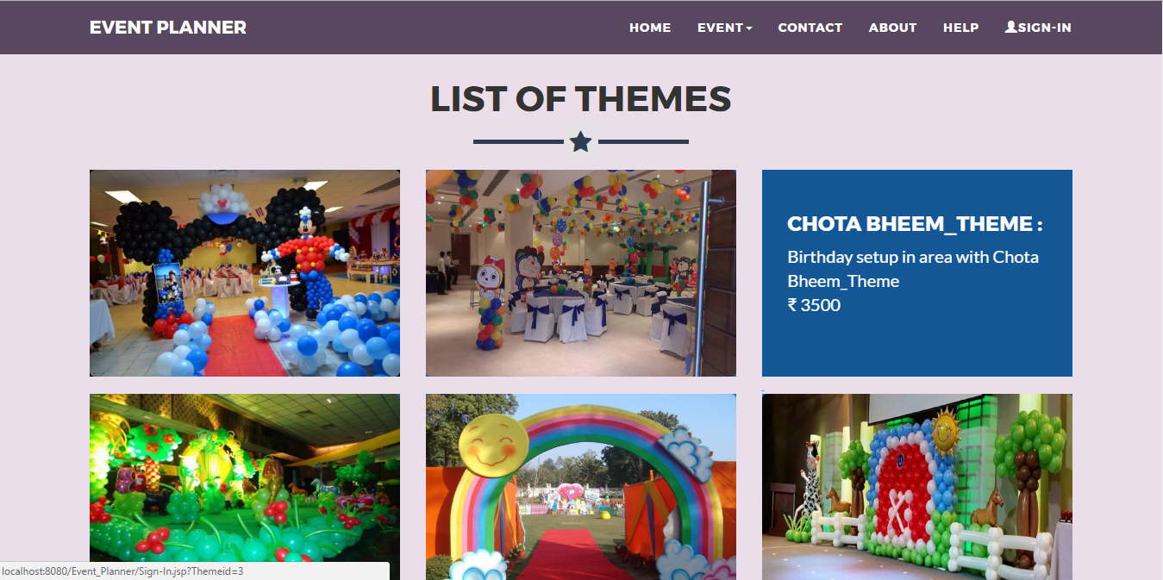

Slide 43
2.Events Page(Brithday Event)

Slide 44
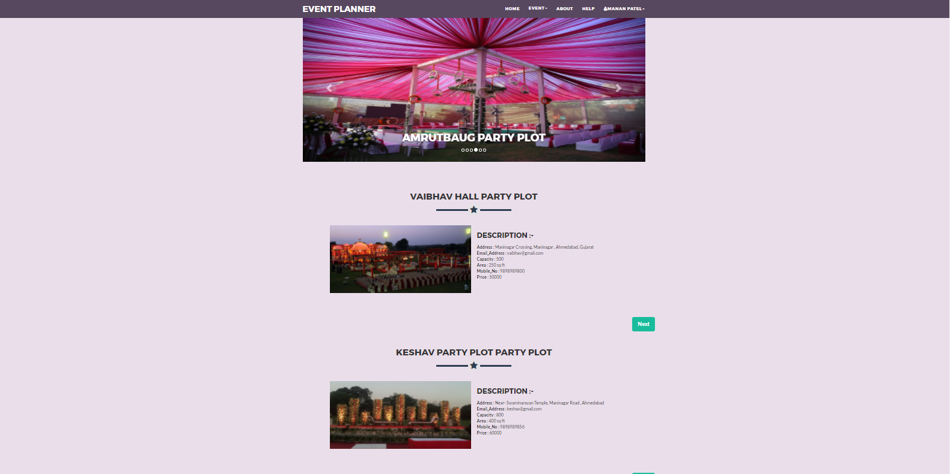
3.Venue Page

Slide 45
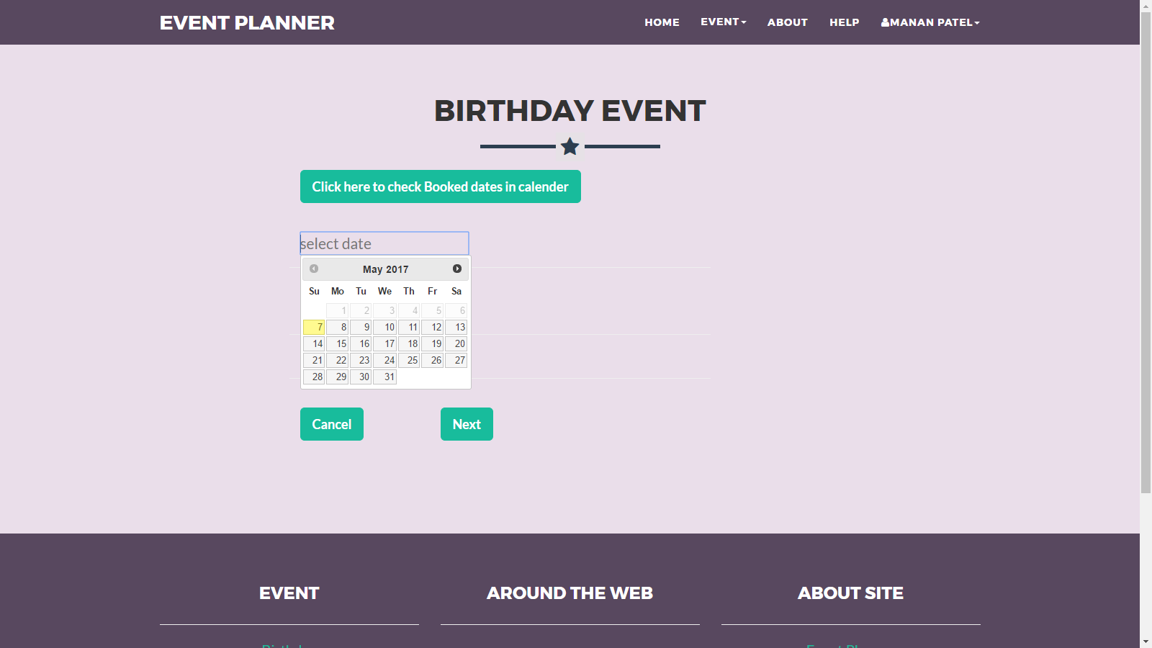
4.Book Page

Slide 46
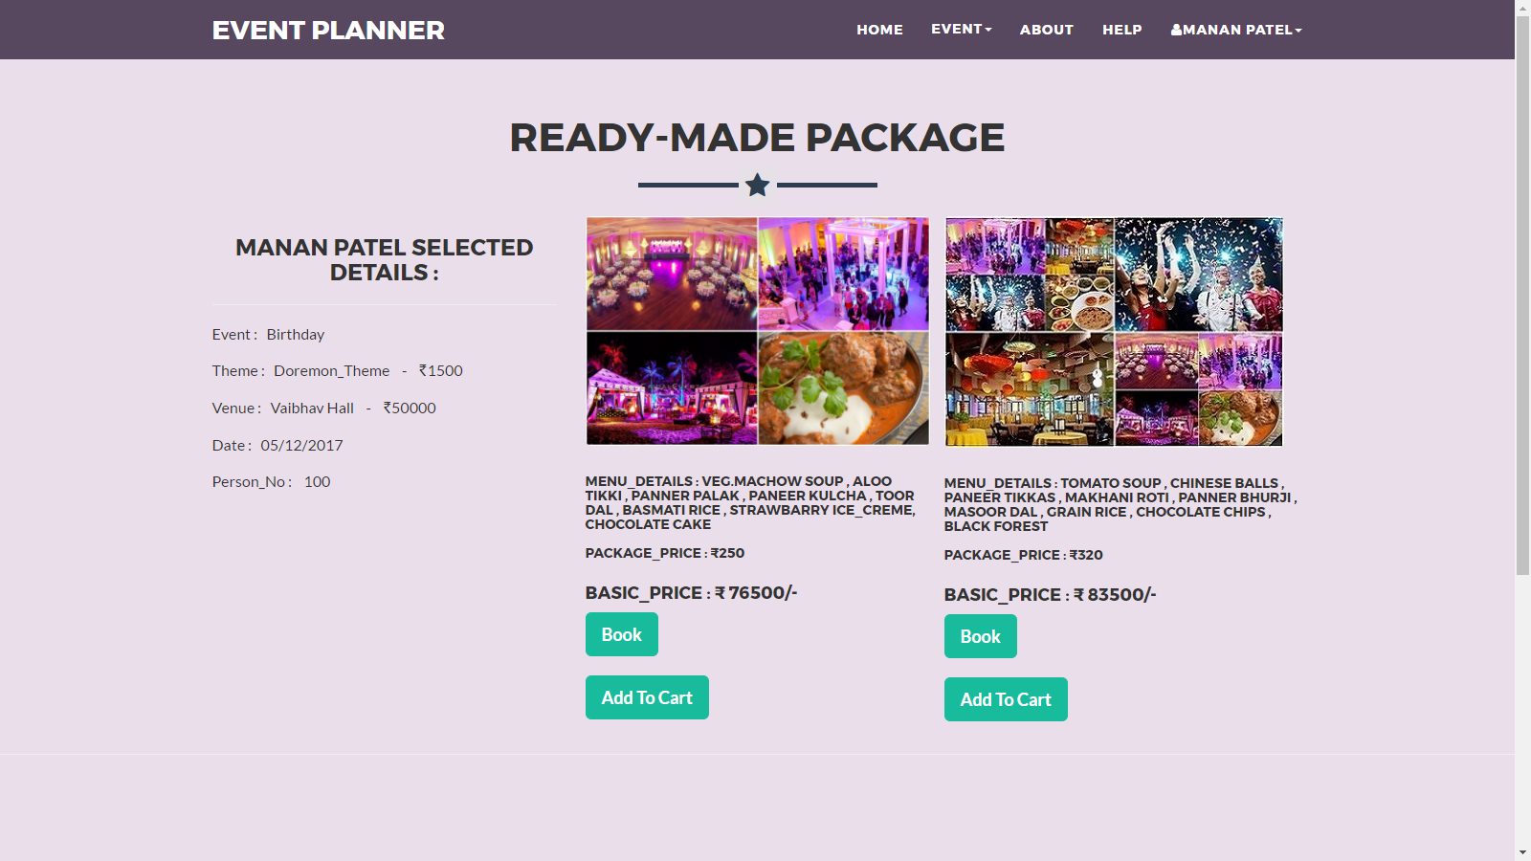
Ready-Made Page

Slide 47
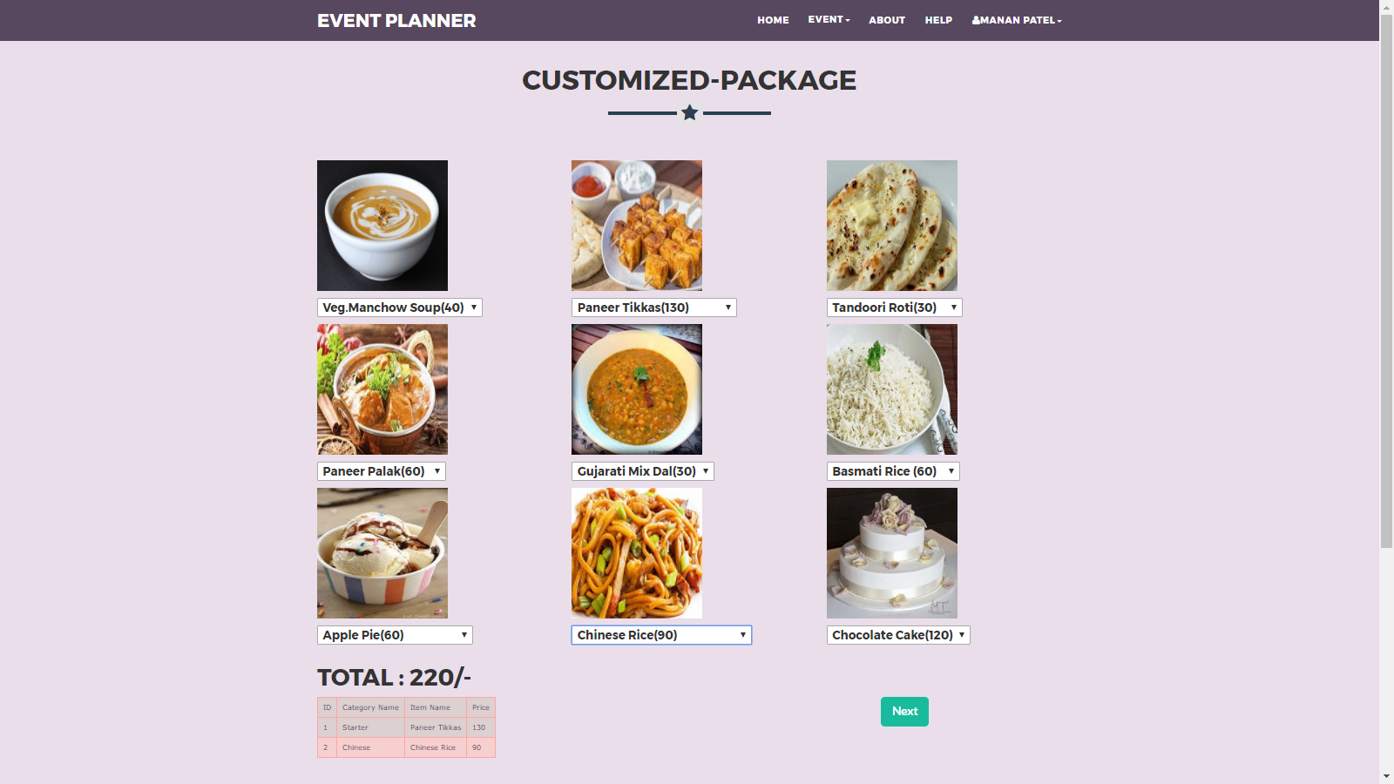
Customize Page

Slide 48
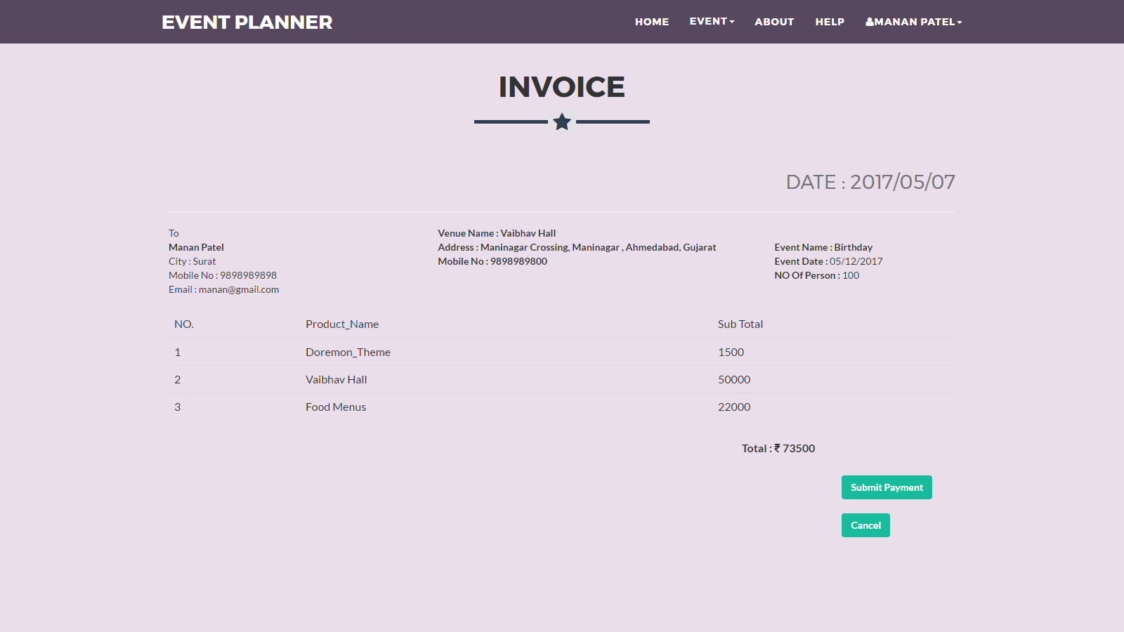
5.Invoice Page

Slide 49
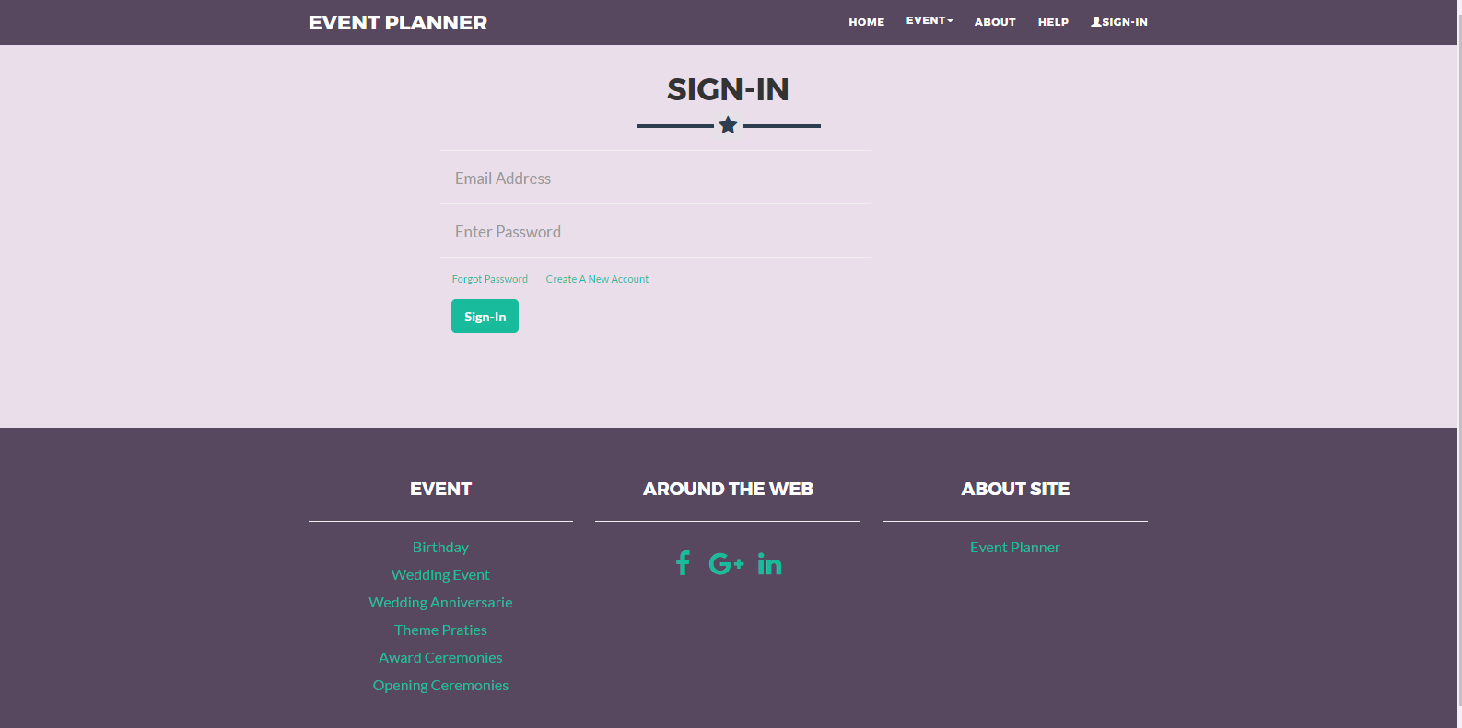
6. Login Page

Slide 50
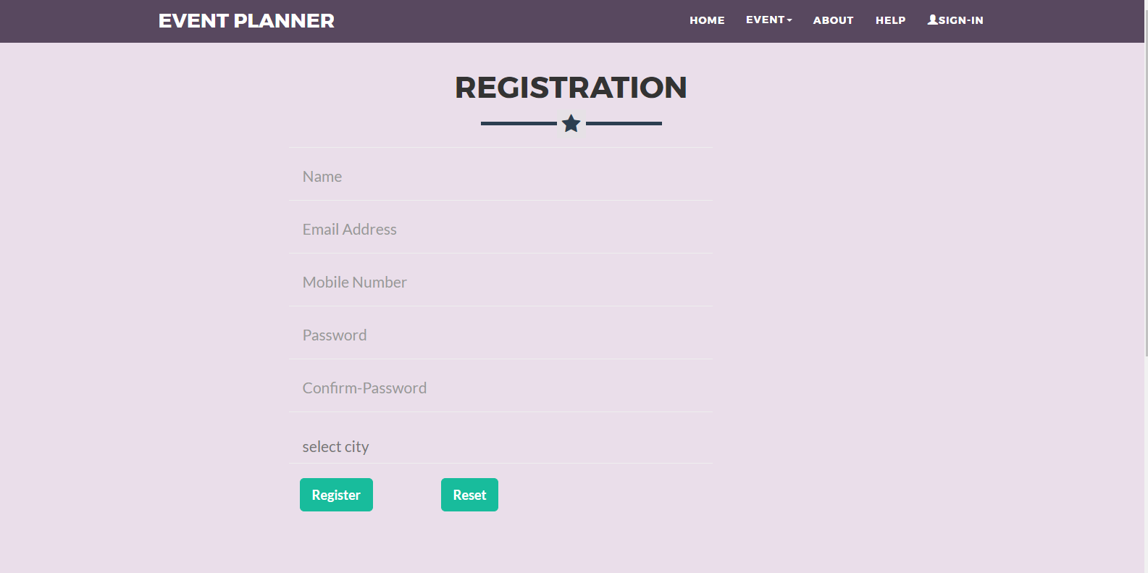
7.Registration Page

Slide 51
Admin Side

Slide 52
Admin Side
1.Home Page
This Page is Represent The Home Page
2.Login
Through this page Website Administrator can Login to the Admin Panel.
3.Book Event
This Page is represent The who user the Book in this Website
4.Menu Master
This Page Admin Add/update/delete The Menu Details.
5.Users Details
This Page Admin Can see The who user can Register in website

Slide 53
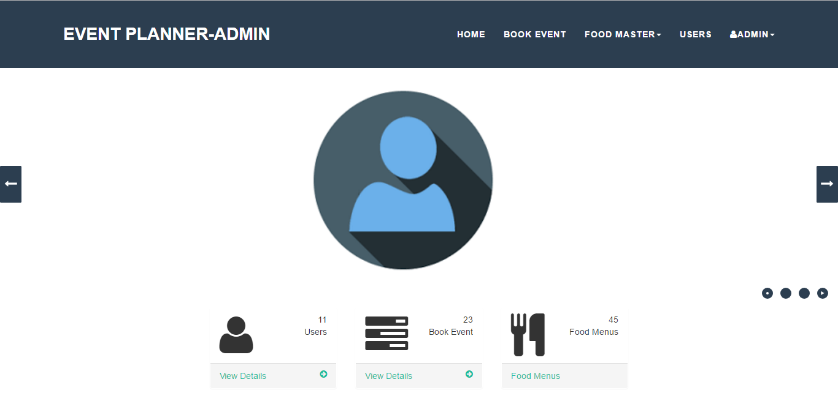
1.Home Page

Slide 54
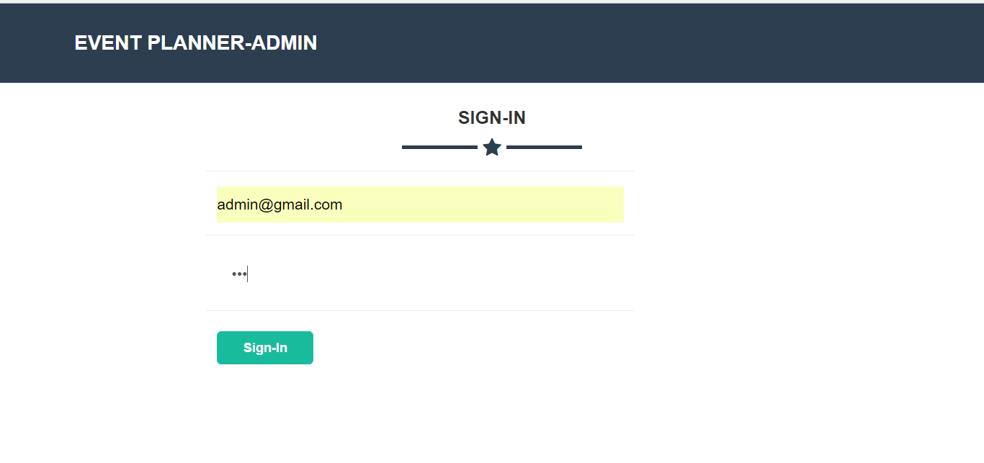
2.Login

Slide 55
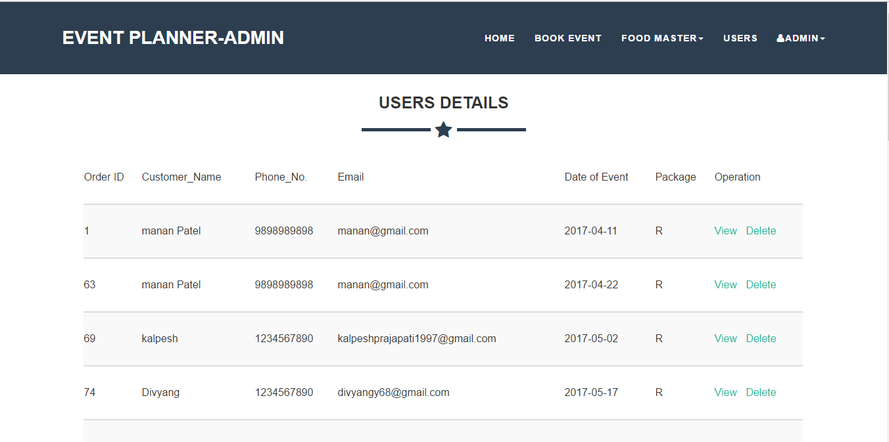
3.Book Event

Slide 56
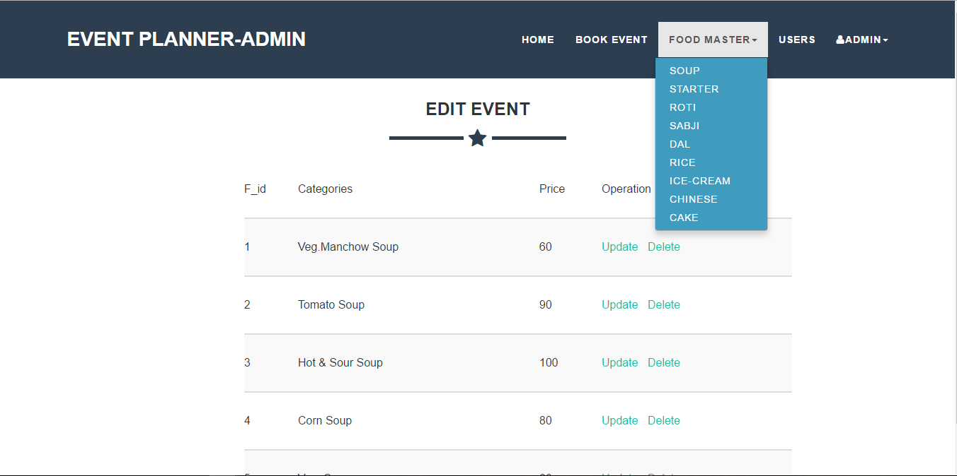
4.Menu Master

Slide 57
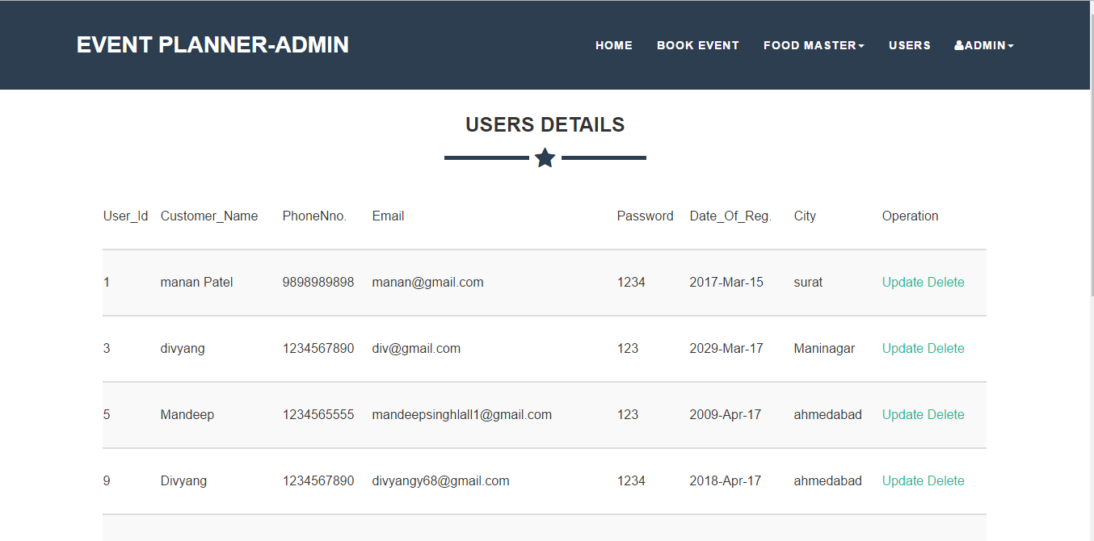
5.Users Details

Slide 58
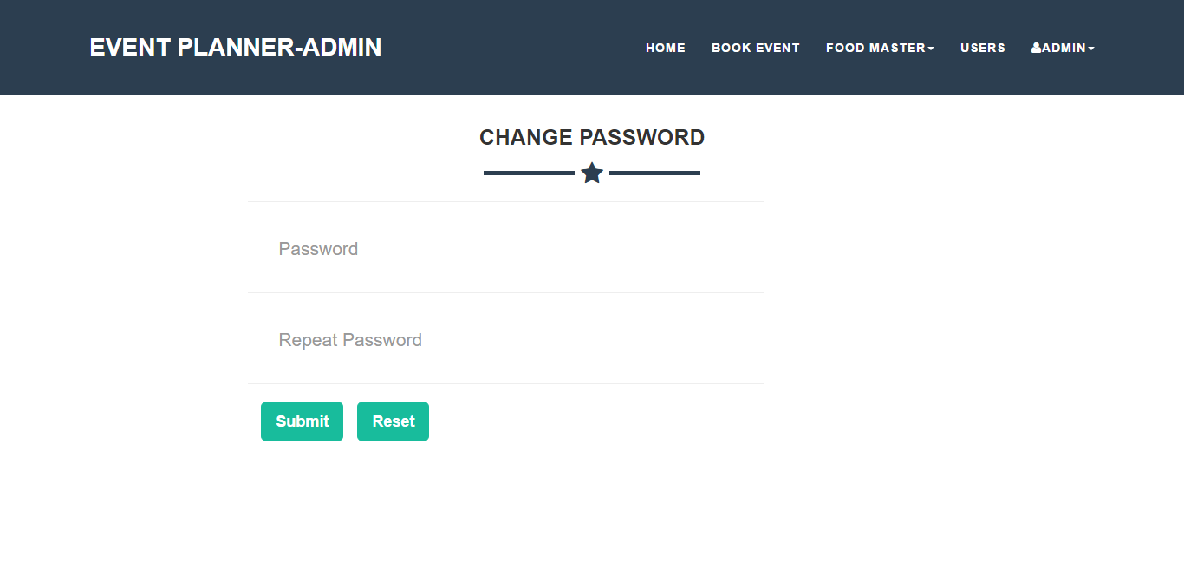
6. Change Password

Slide 59
Future scope of System
Keep records of events history.
After events successful execution survey & feedbacks to make improvements for next time.
Add Modules for system requirements.
Automation of notifications about events.
Improve visiting experience of attendees.

Slide 60
…Thank You…

